Slide 1
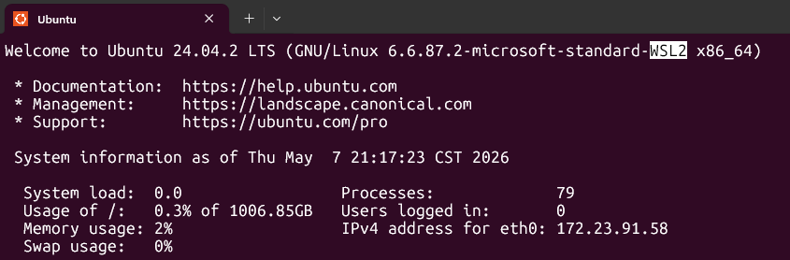
Extra information
You can install WSL2 in Windows to run the doDec.sh and doDec_upscale.sh

Slide 2
Version of ffmpeg
Newer version of ffmpeg complains about “-vsync 0” used in the doDec.sh and doDec_upscale.sh scripts
If the scripts still run, you do not have to do anything
If the scripts do not run owing to this “-vsync 0”, change it from
“-vsync 0” to “-fps_mode passthrough”

Slide 3
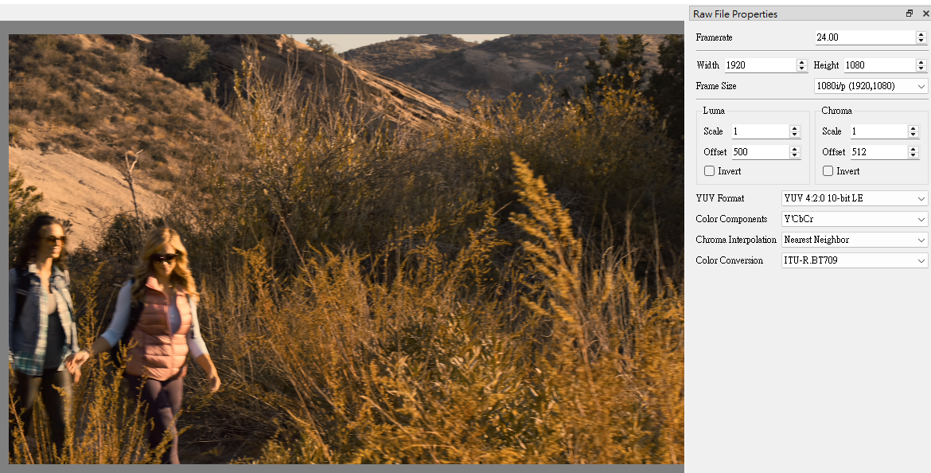
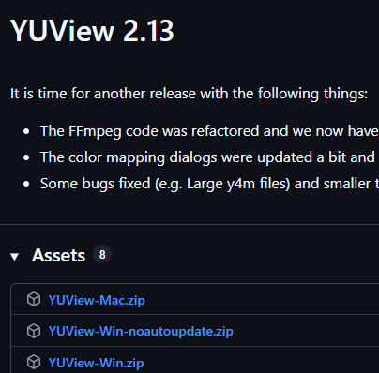
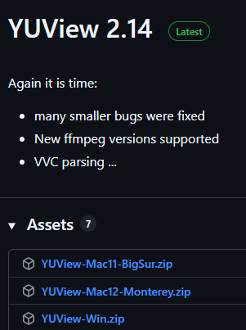
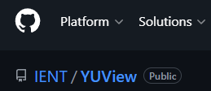
When using YUView, select 10-bit pixel
Use YUView <= 2.13, 2.14 may not work
1080p or 4K
Little Endian

Slide 4
Video file .yuv prefix
Video frames are indexed from 0 (0, 1, 2, 3, 4, 5, 6 ……)
Prefix “odd_” means the .yuv files are with odd frames (1, 3, 5, …)
Prefix “even_” means the .yuv files are with even frames (0, 2, 4, …)

Slide 5
Python package dependency
To calculate BD-rate by the Python script like testOddFramesXXX.py, the only library dependency is “numpy”. Be sure to install numpy before running the scripts.
Extra suggestion (optional)
  Re-write the Python scripts with C++ to accelerate the speed of calculating BD-rate if you expect there will be a lot of iterations of your algorithm
    AI can help!

